Slide 1
ATAI
Advanced Techniqueof Artificial Intelligence
ATAI
ChongqingUniversity _{AdvancedTechniqueof}
of Technology Artificial Intelligence
Chongqing University of
Technology
Chongqing University ^{ATAI}
_{of Technology} Advanced Techniqueof
Artificial Intelligence
Chongqing University of Technology
Chongqing University of Technology
DIFF: Dual Side-Information Filtering and Fusion for
Sequential Recommendation
code: NO
—— SIGIR 2025
Reported by ZhenDong Huang
1

Slide 2
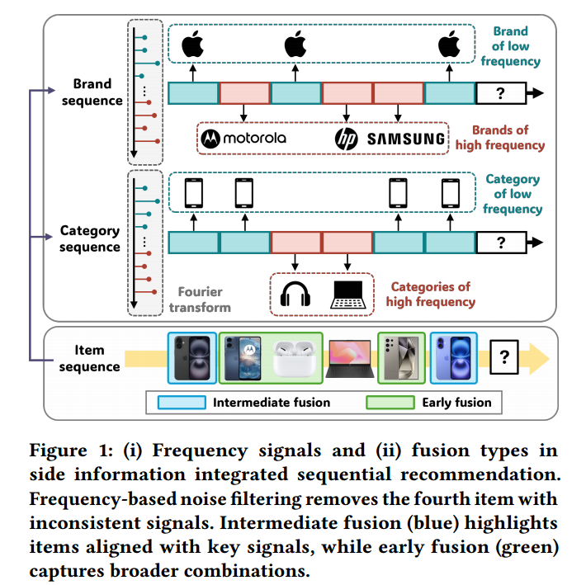
ATAI
AdvancedTechniqueof
Artificial Intelligence
ATAI
ChongqingUniversity _{AdvancedTechniqueof}
of Technology Artificial Intelligence
ChongqingUniversity of Technology
Motivation
1. They are limited in considering a single sequence, focusing solely on item IDs.

Slide 3
ATAI
AdvancedTechniqueof
Artificial Intelligence
ATAI
ChongqingUniversity _{AdvancedTechniqueof}
of Technology Artificial Intelligence
ChongqingUniversity of Technology
Motivation
2. It fails to directly integrate item attributes into user representations, thereby missing strong collaborative signals across attributes

Slide 4
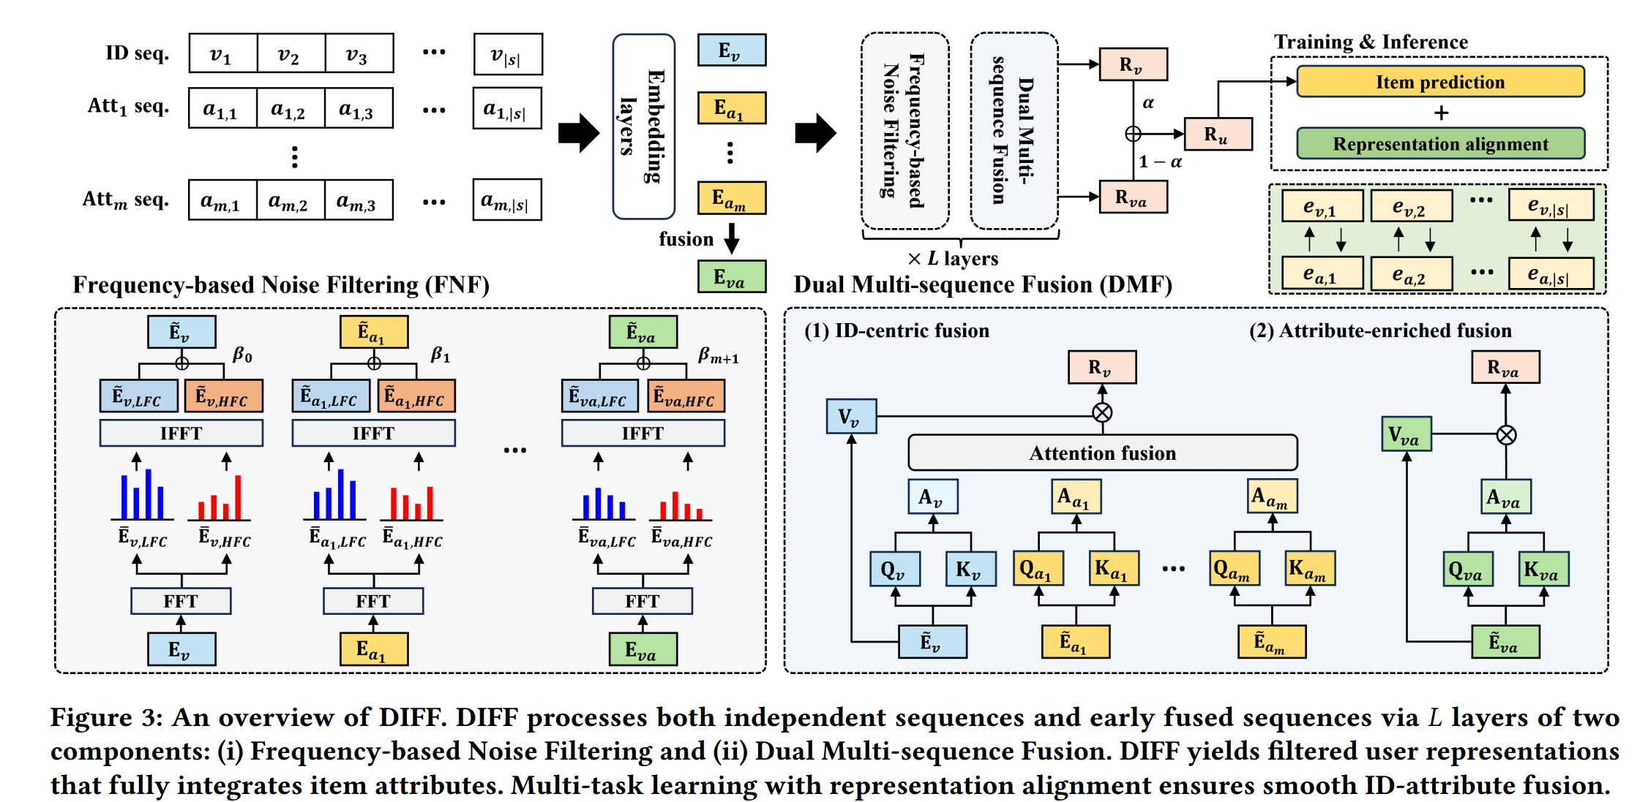
ChongqingUniversity of Technology
ATAI
AdvancedTechniqueof
Artificial Intelligence
ATAI
ChongqingUniversity _{AdvancedTechniqueof}
of Technology Artificial Intelligence
Overview

Slide 5
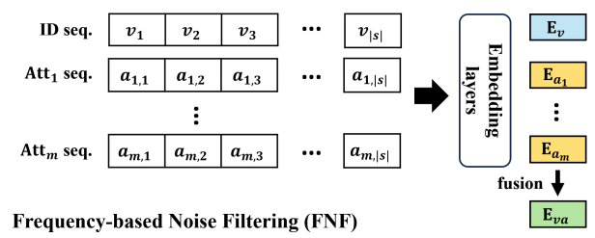
ChongqingUniversity of Technology
ATAI
AdvancedTechniqueof
Artificial Intelligence
ATAI
ChongqingUniversity _{AdvancedTechniqueof}
of Technology Artificial Intelligence
Method

Slide 6
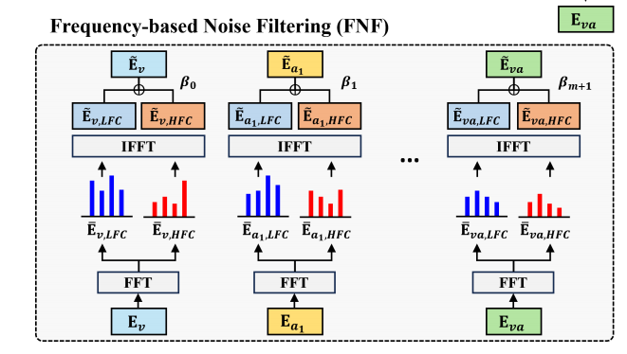
ChongqingUniversity of Technology
ATAI
AdvancedTechniqueof
Artificial Intelligence
ATAI
ChongqingUniversity _{AdvancedTechniqueof}
of Technology Artificial Intelligence
Method

Slide 7
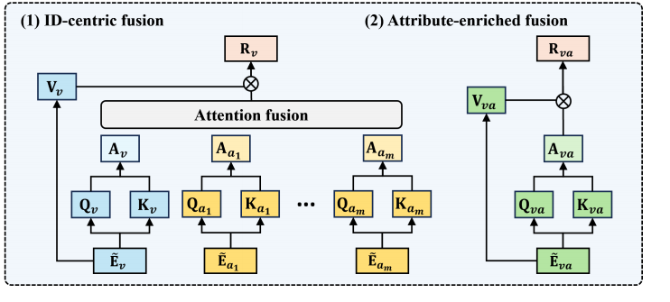
ChongqingUniversity of Technology
ATAI
AdvancedTechniqueof
Artificial Intelligence
ATAI
ChongqingUniversity _{AdvancedTechniqueof}
of Technology Artificial Intelligence
Method

Slide 8
ChongqingUniversity of Technology
ATAI
AdvancedTechniqueof
Artificial Intelligence
ATAI
ChongqingUniversity _{AdvancedTechniqueof}
of Technology Artificial Intelligence
Method

Slide 9
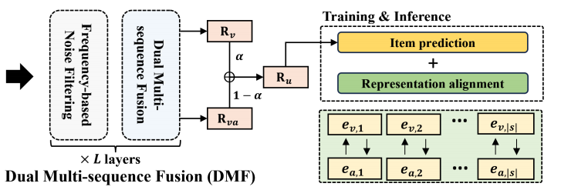
ChongqingUniversity of Technology
ATAI
AdvancedTechniqueof
Artificial Intelligence
ATAI
ChongqingUniversity _{AdvancedTechniqueof}
of Technology Artificial Intelligence
Method

Slide 10
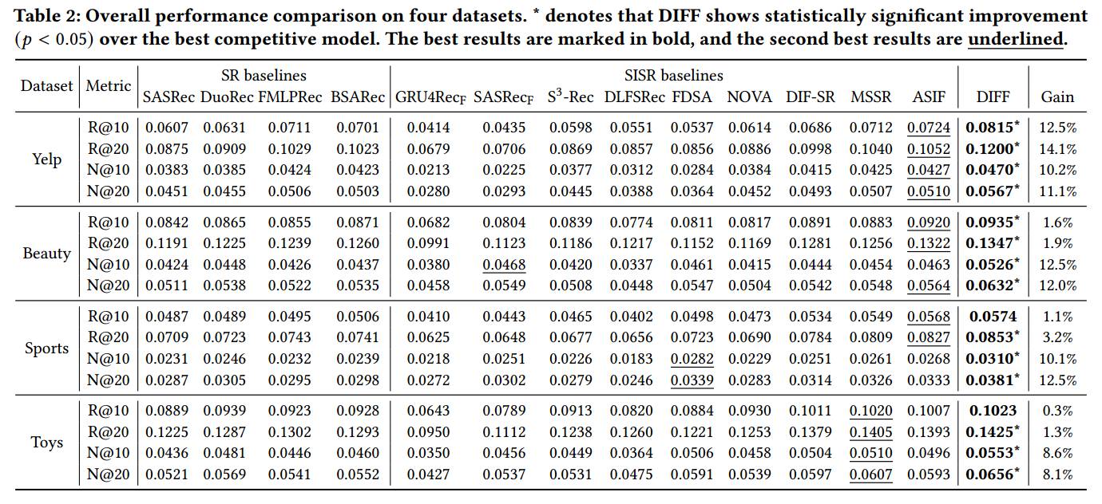
ATAI
AdvancedTechniqueof
Artificial Intelligence
ATAI
ChongqingUniversity _{AdvancedTechniqueof}
of Technology Artificial Intelligence
ChongqingUniversity of Technology
Experiments

Slide 11
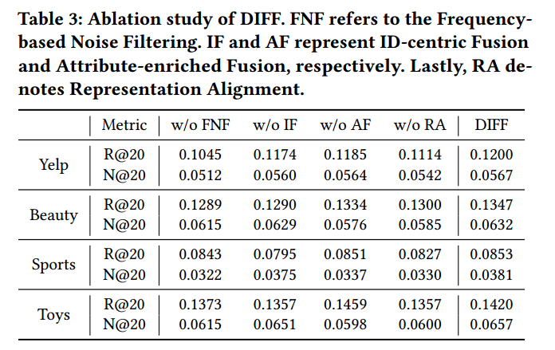
ATAI
AdvancedTechniqueof
Artificial Intelligence
ATAI
ChongqingUniversity _{AdvancedTechniqueof}
of Technology Artificial Intelligence
ChongqingUniversity of Technology
Experiments

Slide 12
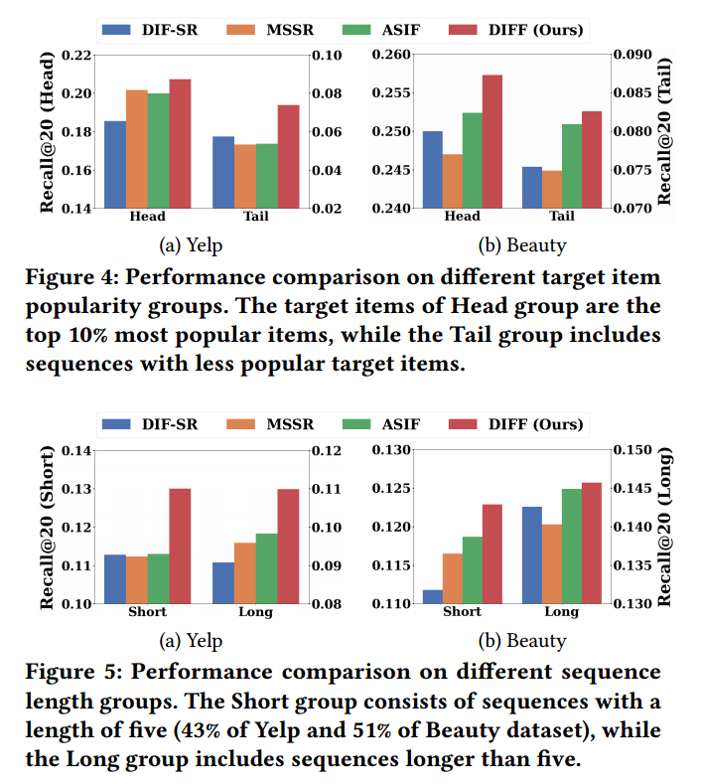
ATAI
AdvancedTechniqueof
Artificial Intelligence
ATAI
ChongqingUniversity _{AdvancedTechniqueof}
of Technology Artificial Intelligence
ChongqingUniversity of Technology
Experiments

Slide 13
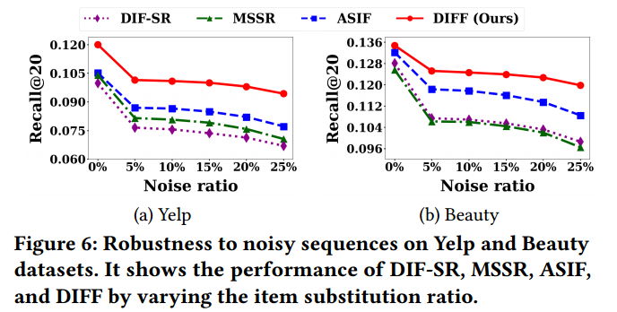
ATAI
AdvancedTechniqueof
Artificial Intelligence
ATAI
ChongqingUniversity _{AdvancedTechniqueof}
of Technology Artificial Intelligence
ChongqingUniversity of Technology
Experiments

Slide 14
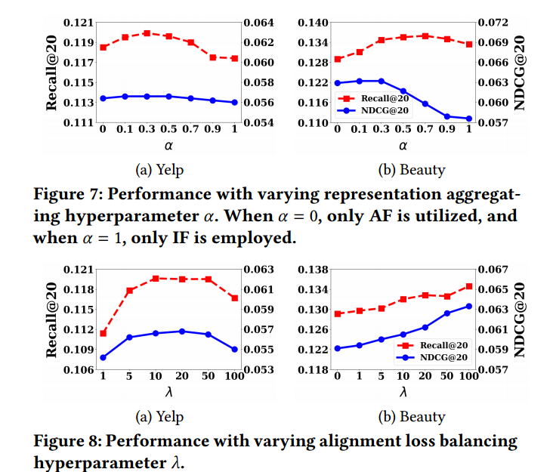
ATAI
AdvancedTechniqueof
Artificial Intelligence
ATAI
ChongqingUniversity _{AdvancedTechniqueof}
of Technology Artificial Intelligence
ChongqingUniversity of Technology
Experiments

Slide 15
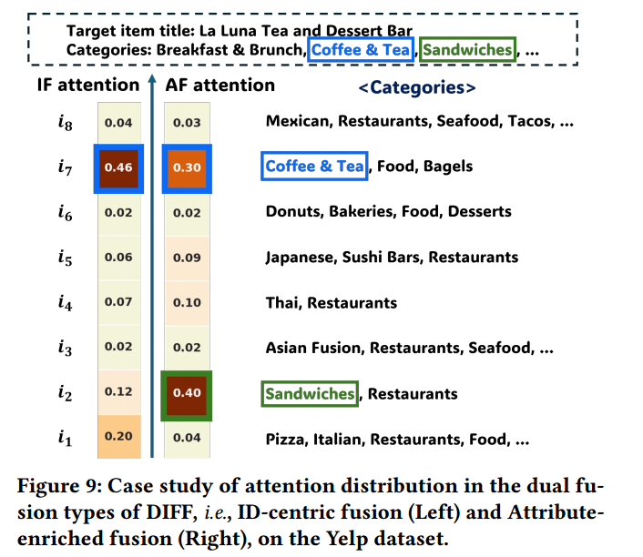
ATAI
AdvancedTechniqueof
Artificial Intelligence
ATAI
ChongqingUniversity _{AdvancedTechniqueof}
of Technology Artificial Intelligence
ChongqingUniversity of Technology
Experiments

Slide 16
ChongqingUniversity of Technology
ATAI
AdvancedTechniqueof
Artificial Intelligence
ATAI
ChongqingUniversity _{AdvancedTechniqueof}
of Technology Artificial Intelligence
Thanks!

